Slide 1
List, Stack Queues
BCA 202

Slide 2
Why study List, Stack, Queue?
Three most simple and basic Data Structures
BTW, What is a Data Structure?
Very Predominant in usage
ADT - Considered on par with a primitive

Slide 3
A few concepts
Abstract Data Types
On par with a primitive data type in languages
What is a primitive?
Concept of Modularity
Concept of Object oriented style (Abstraction)
Properties
Methods
An ADT is a mathematical model for a certain class of data structures that have similar behaviour;
or for certain data types that have similar semantics.
Applicable to many programming languages
Is defined indirectly, by the operations that may be performed on it & by mathematical constraints on the effects of those operations.

Slide 4
Whenever the programming language does not support the data operations, define an ADT and code the operations that it has to do.
(i.e.) identify a data structure and then build the operations

Slide 5
Fundamentals
Node
2 things – a place to store and then a link
Basic bldg block

Slide 6
List
Collection of elements in a specific order
A1, A2…AN
N elements in some order
Many implementations
Array
Linked List
Doubly Linked List
Circular List

Slide 7
Examples of a List
List examples
students in the course
courses offered by the University
subjects taught in a course
Songs in a CD
items in a grocery list
What do we do with a List?

Slide 8
Examples of what we do with a List
myList.createList( ) myList.add(1, milk) myList.add(2, sugar)
myList.add(3, butter)
…
How can we construct this list?
Create an empty list
Use a series of add operations
milk, sugar, butter, apples, bread, jam
How do we insert a new item into a given position?
milk, sugar, butter, apples, bread, jam
myList.add(4, nuts)
Use add operation
milk, sugar, butter, nuts, apples, bread, jam
How do we delete an item from a given position?
Use remove operation
myList.remove(5)
milk, sugar, butter, nuts, bread, jam

Slide 9
Operations
3 broad categories
operations to manage Lists
Initialize a list
Add an item
Delete an item
Predicate operations to test Lists
isEmpty to test if the list is empty
Selector operations to select items of a List
Fetch or Search operation to return one item at a particular position
With these operations we can manipulate lists without knowing anything about how they are implemented, and what data structure has been used to implement them.

Slide 11
Linked List
Consists of a series of structures not necessarily in adjacent spaces
Each element of the structure has the contents plus the address of the next element.

Slide 12
Some of the common operations
Insert (at a certain point)
Search
Delete
Get Next element
Notes:
For the Search method,
<number>

Slide 15
An Impl. example
typedef struct LL {
int myNum;
struct LL *next;
} Element;
Element head;
head.myNum = 0;
head.next = NULL;
ref = &head;
while (i < 10) {
i++;
ref->next = (struct LL *) malloc(sizeof(struct LL));
ref->next->myNum = i;
ref->next->next = NULL;
ref = ref->next;
}
Sample List definition.
Can have any number of items in the element
Initialize header element
Element *ref, *newElem;
Initialize 10 elements in the list. Note malloc procedure.
The definitions are Element *ref, *newElem;

Slide 16
Displaying the elements from the LL
displayList (Element *ref) {
while (ref != NULL) {
printf ("displaying %d\n", ref->myNum);
ref = ref->next;
}
}

Slide 17
Fetching an Element at a given position
Element * fetchElement (Element *ref, int position) {
int i = 0;
while (ref != NULL) {
if (i == position) {
return (ref);
}
ref = ref->next;
i++;
}
return (NULL);
}

Slide 18
Inserting an Element
int insertElement(Element *ele) {
Element *ref;
ref = &head;
while (ref != NULL) {
if (ref->next == NULL) {
ref->next = ele;
return (0);
}
ref = ref->next;
}
return (-1);
}
Insert at the end of the list

Slide 19
Some applications of Linked Lists
Polynomial – addition and multiplication
Radix Sort
Multilist

Slide 20
Polynomial ADT

Slide 21
Polynomial ADT
An example of a single variable polynomial:
4x6 + 10x4 - 5x + 3
Remark: the order of this polynomial is 6
(look for highest exponent)

Slide 22
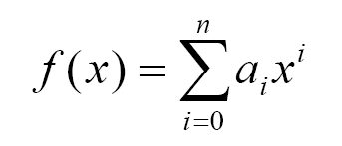
Polynomial ADT
Why call it an Abstract Data Type (ADT)?
A single variable polynomial can be generalized as:

Slide 23
Polynomial ADT (continued)
…This sum can be expanded to:
anxn + a(n-1)x(n-1) + … + a1x1 + a0
Notice the two visible data sets namely: (C and E), where
C is the coefficient object [Real #].
and E is the exponent object [Integer #].

Slide 24
Polynomial ADT (continued)
By definition of data types:
A set of values and a set of allowable operations on those values.
We can now operate on this polynomial the way we like…

Slide 25
Polynomial ADT (continued)
What kinds of operations?
Here are the most common operations on a polynomial:
Add & Subtract
Multiply
Differentiate
Integrate
etc…

Slide 26
Polynomial ADT (continued)
Why implement this?
Calculating polynomial operations by hand can be very cumbersome. Take differentiation as an example:
d(23x9 + 18x7 + 41x6 + 163x4 + 5x + 3)/dx
= (23*9)x(9-1) + (18*7)x(7-1) + (41*6)x(6-1) + …

Slide 27
Polynomial ADT (continued)
different ways of implementing polynomial ADT
Array
(not recommended)
Double Array
(inefficient)
Linked List
(preferred and recommended)

Slide 28
Polynomial ADT (continued)
Array Implementation:
p1(x) = 8x3 + 3x2 + 2x + 6
p2(x) = 23x4 + 18x - 3
p1(x)
p2(x)
0
2
0
2
4
Index represents exponents

Slide 29
Polynomial ADT (continued)
arrays are not good to represent polynomials
p3(x) = 16x21 - 3x5 + 2x + 6
…………
WASTE OF SPACE!

Slide 30
Polynomial ADT (continued)
Advantages of using an Array:
only good for non-sparse polynomials.
ease of storage and retrieval.
Disadvantages of using an Array:
have to allocate array size ahead of time.
huge array size required for sparse polynomials. Waste of space and runtime.

Slide 31
Polynomial ADT (continued)
Double Array Implementation:
Say you want to represent the following two polynomials:
p1(x) = 23x9 + 18x7 - 41x6 + 163x4 - 5x + 3
p2(x) = 4x6 + 10x4 + 12x + 8

Slide 32
Polynomial ADT (continued)
p1(x) = 23x9 + 18x7 - 41x6 + 163x4 - 5x + 3
p2(x) = 4x6 + 10x4 + 12x + 8
Start p1(x)
Start p2(x)
Coefficient
0
2
8
Exponent
End p1(x)
End p2(x)

Slide 33
Polynomial ADT (continued)
Advantages of using a double Array:
save space (compact)
Disadvantages of using a double Array:
difficult to maintain
have to allocate array size ahead of time
more code required for misc. operations.

Slide 34
Polynomial ADT (continued)
Linked list Implementation:
p1(x) = 23x9 + 18x7 + 41x6 + 163x4 + 3
p2(x) = 4x6 + 10x4 + 12x + 8
P1
23
9
18
7
41
6
18
7
3
0
TAIL (contains pointer)
P2
4
6
10
4
12
1
8
0
NODE (contains coefficient & exponent)

Slide 35
Polynomial ADT (continued)
Advantages of using a Linked list:
save space (don’t have to worry about sparse polynomials) and easier to maintain
No need to allocate list size and can declare nodes (terms) only as needed
Disadvantages of using a Linked list :
can’t go backwards through the list
can’t jump to the beginning of the list from the end.

Slide 36
Example of Polynomial add/multiply
2 polynomials at a time!
Use Linked List for storing the polynomials
P1 = 4x2 + 3x – 5
P2 = 2x + 3
4
2
3
1
-5
0
2
1
3
0

Slide 37
First step
Identify the main operations along with their signature (input and output)
Add 2 polynomials
Multiply them
There are a set of secondary operations required
E.g. Display list
Fetch an element from the list given the power
Each of these operations are expected to return a new polynomial (p3)

Slide 38
Second step
Visualize the pseudo code for each of the operations
Fetch
InsertElement
Inputs: coefft (int), power(int), pointer to Polynomial)
3 cases
When the List itself is new
When the list is not new but Power already exists
When the Power is to be added

Slide 39
Third Step
Start to code the algorithm by implementing the operations
Test

Slide 40
List Definition
typedef struct polynomial {
int coefft;
int power;
struct polynomial *next;
} Polynomial;

Slide 41
Insert – new list
Polynomial *insertElement(int c, int p, Polynomial *pHead) {
Polynomial *ref, *prevPtr=NULL;
ref = pHead;
//When it is the 1st element (head NULL)
if (ref == NULL) {
ref = malloc(sizeof(Polynomial));
ref->coefft = c;
ref->power = p;
ref->next = NULL;
return(ref);
}
...

Slide 42
Insert – P already exists in the list
//Find if Power, P already exists in the polynomial
while (ref != NULL) {
if (ref->power == p) {
// power already exists, so add the coefft (instead of replacing)
ref->coefft += c;
return(ref);
}
//store this element to reference when this power does not exist yet
prevPtr = ref;
ref = ref->next;
}

Slide 43
Insert – new Power
//This power does not exist, so add this
if (prevPtr != NULL) {
prevPtr->next = malloc(sizeof(Polynomial));
prevPtr->next->coefft = c;
prevPtr->next->power = p;
prevPtr->next->next = NULL;
return(prevPtr->next);
}
return (NULL);

Slide 44
Polynomial ADT (continued)
Adding polynomials using a Linked list representation: (storing the result in p3)
To do this, we have to break the process down to cases:
Case 1: exponent of p1 > exponent of p2
Copy node of p1 to end of p3.
[go to next node]
Case 2: exponent of p1 < exponent of p2
Copy node of p2 to end of p3.
[go to next node]

Slide 45
Polynomial ADT (continued)
Case 3: exponent of p1 = exponent of p2
Create a new node in p3 with the same exponent and with the sum of the coefficients of p1 and p2.

Slide 46
Polynomial ADT (continued)
Introducing Horner’s rule:
Suppose for simplicity we use an array to represent the following non-sparse polynomial:
4x3 + 10x2 + 5x + 3
Place it in an array, call it a[i], and compute it…

Slide 47
Polynomial ADT (continued)
4x3 + 10x2 + 5x + 3
A general (and inefficient) algorithm:
int Poly = 0;
int Multiply;
for (int i=0; i < a.Size; i++)
{
Multiply =1;
for (int j=0; j<i; j++)
{
Multiply *= x;
}
Poly += m*a[i];
}
Time Complexity O(n2)

Slide 48
Polynomial ADT (continued)
4x3 + 10x2 + 5x + 3
Now using Horner’s rule algorithm:
int Poly = 0;
for (int i = (a.Size-1); i >= 0 ; i++)
{
Poly = x * Poly + a[i];
}
Time Complexity O(n) ← MUCH BETTER!

Slide 49
Polynomial ADT (continued)
So what is Horner’s rule doing to our polynomial?
instead of: ax2 + bx + c
Horner’s simplification: x(x(a)+b)+c

Slide 50
Polynomial ADT (continued)
So in general
anxn + a(n-1)x(n-1) + … + a1x1 + a0
EQUALS:
(((an + a(n-1) )x + a(n-2) )x + … + a1)x + a0

Slide 51
Radix Sort

Slide 52
Another application of LL
Bucket Sort
Sort a list of N numbers with range high value of M
E.g. [4,1,5,6,9,87,66,3,44] has N=9 and M=87
Create an array, A, of 87 elements initialized to 0
Increment ith element of the array for each element i of the array
(i.e.) increment A[4] by 1 for the 1st element, A[1] by 1, A[5] by 1, and so on for each element of array A
Write the pseudo logic and estimate its Big-O

Slide 53
Radix Sort
Roughly we can say a radix is a position in a number. In the decimal system, a radix is just a digit in a decimal number.
For example the number « 42 » has two digits, or two radices, which are 4 and 2. In hexadecimal the radix is 8 bits wide. For example the hexadecimal number 0xAB has two radices, A and B.
The Radix Sort gets its name from those radices, because the method first sorts the input values according to their first radix, then according to the second one, and so on.
It is a multi-pass sort, and the number of passes equals the number of radices in the input values. For example you’ll need 4 passes to sort standard 32 bits integers, since in hexadecimal the radix is a byte. By the way that’s why the Radix Sort is often called Byte Sort.

Slide 54
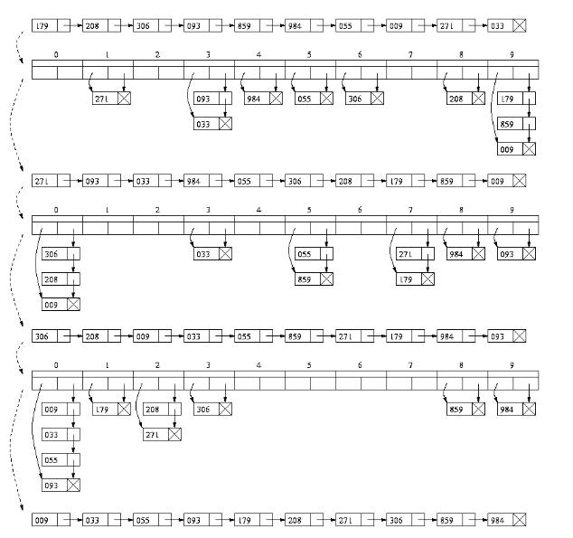
Step-1
Step-2
Step-3

Slide 55
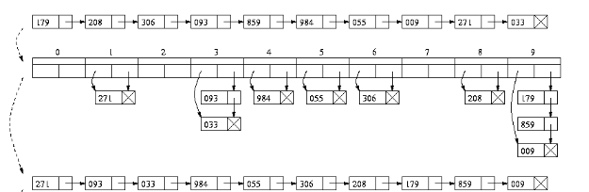
Step-1

Slide 56
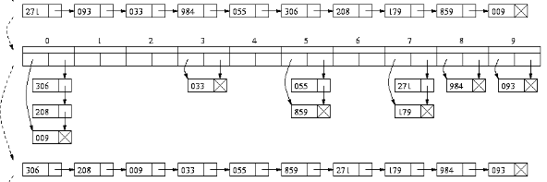
Step-2

Slide 57
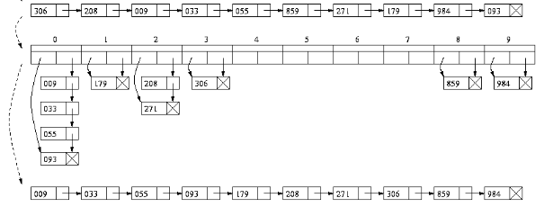
Step-3

Slide 58
Radix – complexity analysis
Time
Each pass through the array takes O(n) time. If the maximum magnitude of a number in the array is `v', and we are treating entries as base `b' numbers, then 1+floor(logb(v)) passes are needed.
If `v' is a constant, radix sort takes linear time, O(n). Note however that if all of the numbers in the array are different then v is at least O(n), so O(log(n)) passes are needed, O(n.log(n))-time overall..
Space
If a temporary array is used, the extra work-space used is O(n). It is possible do the sorting on each digit-position in-situ and then only O(log(n)) space is needed to keep track of the array sections yet to be processed, either recursively or on an explicit stack.

Slide 59
Recap Notes on nLogN
O(log N) and O(N log N) might seem a bit scary, but they're really not. These generally mean that the algorithm deals with a data set that is iteratively partitioned, like a balanced binary tree.
(Unbalanced binary trees are O(N2) to build, and O(N) to probe.) Generally, but not always, log N implies log2N, which means, roughly, the number of times you can partition a set in half, then partition the halves, and so on, while still having non-empty sets. Think powers of 2, but worked backwards.
210 = 1024 log21024 = 10
The key thing to note is that log2N grows slowly. Doubling N has a relatively small effect.
Logarithmic curves flatten out nicely. It takes O(log N) time to probe a balanced binary tree, but building the tree is more expensive.
If you're going to be probing a data set a lot, it pays to take the hit on construction to get fast probe time.
Quite often, when an algorithm's growth rate is characterized by some mix of orders, the dominant order is shown, and the rest are dropped. O(N2) might really mean O(N2 + N).

Slide 60
Stacks & Queues
A stack is an ordered list in which all insertions and deletions are made at one end, called the top.
Contrast with a queue is an ordered list in which all insertions take place at one end, the rear, while all deletions take place at the other end, the front.
The Queue and Stack differ from the List class in that there are limitations on how the Queue and Stack data can be accessed.
Given a stack S=(a[1],a[2],.......a[n]) then we say that a1 is the bottommost element and element a[i]) is on top of element a[i-1], 1<i<=n.
When viewed as a queue with a[n] as the rear element one says that a[i+1] is behind a[i], 1<i<=n.
Notes:
The term “stack” is intended to conjure up visions of things encountered in daily life, such as a stack of dishes in a college cafeteria or a stack of books on your desk. In common English usage, “stack of” and “pile of” are synonymous. To computer scientists, however, a stack is not just any old pile. A stack has the property that the last item placed on the stack will be the first item to be removed. This property is commonly referred to as “last-in-first-out” or simply LIFO. The last item placed on the stack is called the “top” item in the stack. Access procedures for this type of Abstract Data type can therefore only examine the top item.
The LIFO property of a stack seems inherently unfair. How would you like to be the first person to arrive on the “stack” for a movie (as opposed to a line for a movie). You would be the last person to be allowed in! Stack are not especially prevalent in everyday life. The property that we usually desire in our daily life is “first-in-first-out” (or FIFO). A queue is the Abstract Data Type with the FIFO property. Most people would much prefer to wait in a movie queue (or in a line) than in a movie stack! However, while the LIFO property is not very appropriate for many day-to-day situations, it is very much needed for a large number of problems that arise in computer science.
The access procedures for a stack include operations such as examining whether the stack is empty (but not how many items are in the stack), inspecting the top item but not others, placing an item on top of the stack, but at no other position, and removing an item from the top of the stack, but from no other position. Stacks can therefore be seen as special lists with access procedures restricted to just the top element.
<number>

Slide 61
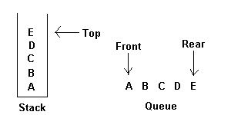
Stack
A Stack can be visualized graphically as a vertical collection of items. When an item is pushed onto the stack, it is placed on top of all other items. Popping an item removes the item from the top of the stack. The following two figures graphically represent a stack first after items 1, 2, and 3 have been pushed onto the stack in that order, and then after a pop.
The restrictions on a stack imply that if the elements A,B,C,D,E are added to the stack, n that order, then th efirst element to be removed/deleted must be E. Equivalently we say that the last element to be inserted into the stack will be the first to be removed. For this reason stacks are sometimes referred to as Last In First Out (LIFO) lists.

Slide 62
Stacks
stack is generally implemented with only two principle operations (apart from a constructor and destructor methods)
Other methods are also used

Slide 63
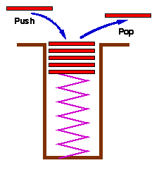
Stacks – another view
A common model of a stack is a plate or coin stacker. Plates are "pushed" onto to the top and "popped" off the top. Stacks form Last-In-First-Out (LIFO) queues and have many applications
A stack is simply another collection of data items and thus it would be possible to use exactly the same specification as the one used for our general collection. However, collections with the LIFO semantics of stacks are so important in computer science that it is appropriate to set up a limited specification appropriate to stacks only.
Although a linked list implementation of a stack is possible (adding and deleting from the head of a linked list produces exactly the LIFO semantics of a stack), the most common applications for stacks have a space restraint so that using an array implementation is a natural and efficient one (In most operating systems, allocation and de-allocation of memory is a relatively expensive operation, there is a penalty for the flexibility of linked list implementations.)

Slide 64
When talking about queues it's easy to conjure up many real-world parallels like lines at the bakery, printer job processing, and so on. But real-world examples of stacks in action are harder to come up with. Despite this, stacks are a prominent data structure in a variety of computer applications.
call stack in program function execution
commonly used in parsing grammars or as a means to simulate recursion, and even as an instruction execution model.
Notes:
<number>

Slide 65
Stack Frames
Programs compiled from modern high level languages make use of a stack frame for the working memory of each procedure or function invocation.
When any procedure or function is called, the stack frame - is pushed onto a program stack.
When the procedure or function returns, this frame of data is popped off the stack.
As a function calls another function, first its arguments, then the return address and finally space for local variables is pushed onto the stack.
Since each function runs in its own "environment" or context, it becomes possible for a function to call itself - a technique known as recursion.

Slide 66
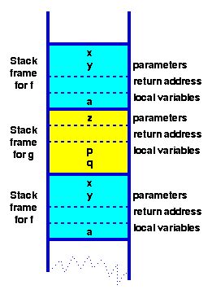
Stack Frames
Code snippet
function f(int x, int y) {
int a;
if ( term_cond ) return ...;
a = .....;
return g(a);
}
function g(int z) {
int p,q; p = ...;
q = ...;
return f(p,q);
}

Slide 67
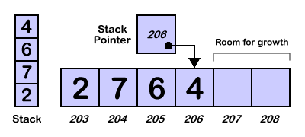
Stack – Array Implementation
Array Implementation
we need to reserve a block of memory cells large enough to hold all the items we want to put on the stack.
a stack pointer holds the location of the top of our stack. As the stack grows and shrinks, this pointer is updated so that it always points to the top item of the stack.

Slide 68
Stack Implementation
Notice that our array implementation retains one of the problems we saw with the array implementation of an ordered list. Since our array is a fixed size, our stack can only grow to a certain size. Once our stack is full, we will have to use the PopStackItem operation before we can push any more items onto the stack. To make the size of our stack more flexible, we can use pointers to implement the stack.

Slide 69
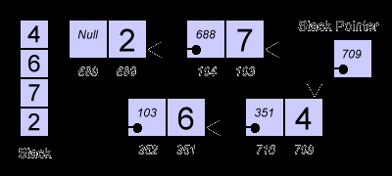
Stack
need a special pointer to keep track of the top of our stack.
we need to link nodes (groups of memory cells) together just like we did for the pointer implementation of a list. Each node contains a stack item and a pointer to the next node.
To push an item onto the stack, we need to find a free memory location, set the pointer of the new location to the top of the stack, and finally set the stack pointer to the new location.
The order of these operations is very important. If we set the stack pointer to the location of the new memory first, we will lose the location of the top of our stack.

Slide 70
Assignment
Implement stack operations – Push and Pop
Pop()
Push(value)

Slide 71
RPN / Postfix
Reverse Polish Notation
Jan Lukasiewicz, showed that by writing operators in front of their operands, instead of between them, brackets were made unnecessary.
Later Charles L. Hamblin proposed a scheme in which the operators follow the operands (postfix operators), resulting in the Reverse Polish Notation. This has the advantage that the operators appear in the order required for computation.
In RPN the example "(1+2) * 3" becomes: 3 2 1 + *
“1 + (4 * 5) can be expressed in RPN as 1 4 5 * +

Slide 72
Stack operations
You need to think of entering numbers as being like putting plates into one of those spring loaded plate stacking trolleys you get in canteens. Every time you enter a number, it is pushed onto the stack. When you eventually start using arithmetic operators, numbers start "popping" off the stack as needed. You can also push more numbers onto the stack. At the end of the calculation you will have "used up" all the numbers and the stack will be empty.
If a value appears next in the expression, push this value on to the stack.
If an operator appears next, pop two items from the top of the stack and push the result of the operation on to the stack.

Slide 73
The evaluation algorithm then reads in stuff until it hits the first operator “*”. Then it multiplies the two numbers before it and shoves the result back in
“1 4 5 * +” => “1 [4 5 *] +”,
then becomes “1 20 +” (square brackets added to show the operation).
Then it hits the “+”, and adds the two numbers before it and we finally get 21.

Slide 74

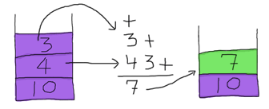
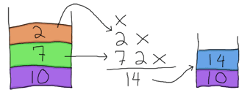

Example
10 4 3 + 2 * -

Slide 75
Steps – Convert Infix to Postfix
Scan the Infix string from left to right.
Initialize an empty stack.
Conditions
If the scanned character is an operand, add it to the Postfix string.
If the scanned character is an operator and if the stack is empty Push the character to stack.
If the scanned character is an Operand and the stack is not empty, compare the precedence of the character with the element on top of the stack (topStack). If topStack has higher precedence over the scanned character Pop the stack else Push the scanned character to stack. Repeat this step as long as stack is not empty and topStack has precedence over the character.
Repeat this step till all the characters are scanned.
(After all characters are scanned, we have to add any character that the stack may have to the Postfix string.) If stack is not empty add topStack to Postfix string and Pop the stack. Repeat this step as long as stack is not empty.
Return the Postfix string.

Slide 76
Example Conversion
Infix String : 25+6*7-8
Initially the Stack is empty and our Postfix string has no characters. Now, the first character scanned “25” is added to the Postfix string. The next character scanned is '+'. It being an operator, it is pushed to the stack.

Slide 77
Example Conversion
Infix String : 25+6*7-8
Next character scanned is ‘6' which will be placed in the Postfix string. Next character is '*' which is an operator. Now, the top element of the stack is '+' which has lower precedence than '*', so '*' will be pushed to the stack.

Slide 78
Example Conversion
Infix String : 25+6*7-8
The next character is ‘7' which is placed in the Postfix string. Next character scanned is '-'. The topmost character in the stack is '*' which has a higher precedence than '-'.
Thus '*' will be popped out from the stack and added to the Postfix string. Even now the stack is not empty. Now the topmost element of the stack is '+' which has equal priority to '-'. So pop the '+' from the stack and add it to the Postfix string. The '-' will be pushed to the stack.

Slide 79
Example Conversion
Infix String : 25+6*7-8
Next character is ‘8' which is added to Postfix string. Now all characters have been scanned so we must pop the remaining elements from the stack and add it to the Postfix string.
At this stage we have only a '-' in the stack. It is popped out and added to the Postfix string.
So, after all characters are scanned, this is how the stack and Postfix string will be

Slide 80
Extras

Slide 81
DS
a data structure is a specific way of storing and organizing data for efficiently use
used in almost every program or software system
provide a means to manage huge amounts of data efficiently,
Databases
indexing services.
efficient data structures are a key to designing efficient algorithms

Slide 82
Examples of DS
Array
stores a number of elements of the same type in a specific order.
accessed using an integer to specify which element is required
Record (also called tuple or struct)
are among the simplest data structures. A record is a value that contains other values, typically in fixed number and sequence and typically indexed by names. The elements of records are usually called fields or members.
hash or dictionary or map
more flexible variation on a record, in which name-value pairs can be added and deleted freely.
Set
An abstract data structure that can store specific values, without any particular order, and no repeated values.
object
contains a number of data fields, like a record, and also a number of program code fragments for accessing or modifying them.

Slide 83
Data Types
Primitive types
Boolean (for boolean values True/False)
Char (for character values)
Float (for storing real number values)
Double (a larger size of type float)
int (for integral or fixed-precision values)
String (for string of chars)
Enumerated type
Composite types
Array
Record (also called tuple or struct)
Union
Tagged union (also called a variant, variant record, discriminated union, or disjoint union)
Plain old data structure
Abstract data types
Map/Associative array/Dictionary
Queue
Set
Stack
String
Tree
Graph
Hash
…
back

Slide 84
Address
Address is a pointer to some data structure
The DS could be a complex structure, or one of the primitives
A pointer is just a variable
back

Slide 85
Variations of Linked Lists
Circular linked lists
The last node points to the first node of the list
How do we know when we have finished traversing the list? (Tip: check if the pointer of the current node is equal to the head.)
A
B
C
Head

Slide 86
Variations of Linked Lists
Doubly linked lists
Each node points to not only successor but the predecessor
There are two NULL: at the first and last nodes in the list
Advantage: given a node, it is easy to visit its predecessor. Convenient to traverse lists backwards

A
B
C

Head

Slide 87
Array versus Linked Lists
Linked lists are more complex to code and manage than arrays, but they have some distinct advantages.
Dynamic: a linked list can easily grow and shrink in size.
We don’t need to know how many nodes will be in the list. They are created in memory as needed.
In contrast, the size of a C++ array is fixed at compilation time.
Easy and fast insertions and deletions
To insert or delete an element in an array, we need to copy to temporary variables to make room for new elements or close the gap caused by deleted elements.
With a linked list, no need to move other nodes. Only need to reset some pointers.

Slide 88
Recap
Have seen what a List is
Different types of list
Implementations

